Slide 1
A simple Pipeline
By CMD I wanted to gather data from a file and modify it with a Python program to finally save it in a new file.

Slide 2


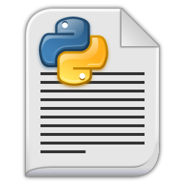


How it works
input.txt
Form where get data
Pipeline
output.csv
our_program.py
Python program
CMD
Win10 executioner
I followed this tutorial and added an adjustments in Python program

Slide 3
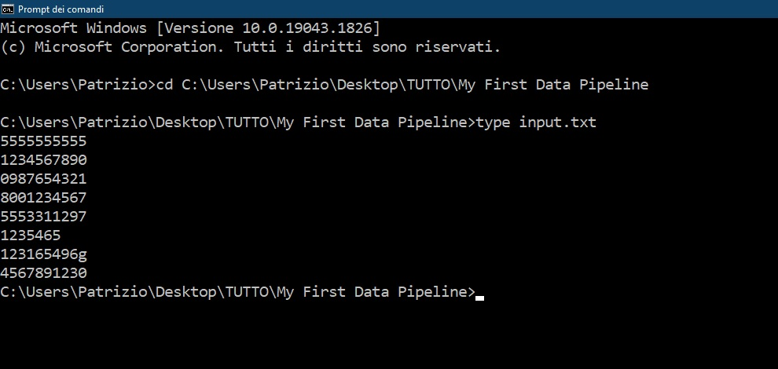
Input.txt shown with CMD
It’s a really simple list of numerical values and not. This is the raw input file from where to start.

Slide 4
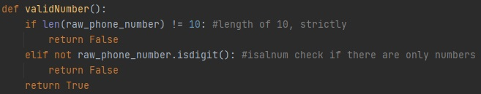
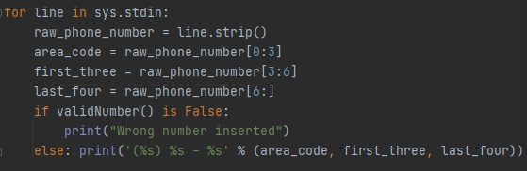
our_program.py
Here I insert a custom function to verify if strings are phone numbers or not.
Checks are:
Is 10 characters long?
Are there all numbers?
Here I define how to treat input file.
Firstly I remove spaces between output rows by using .strip(), then value is trimed and at the end I apply the custom function validNumber() that decides what to print for each row value.
If the line is ok, it will print number with format (XXX) – XXX - XXXX

Slide 5
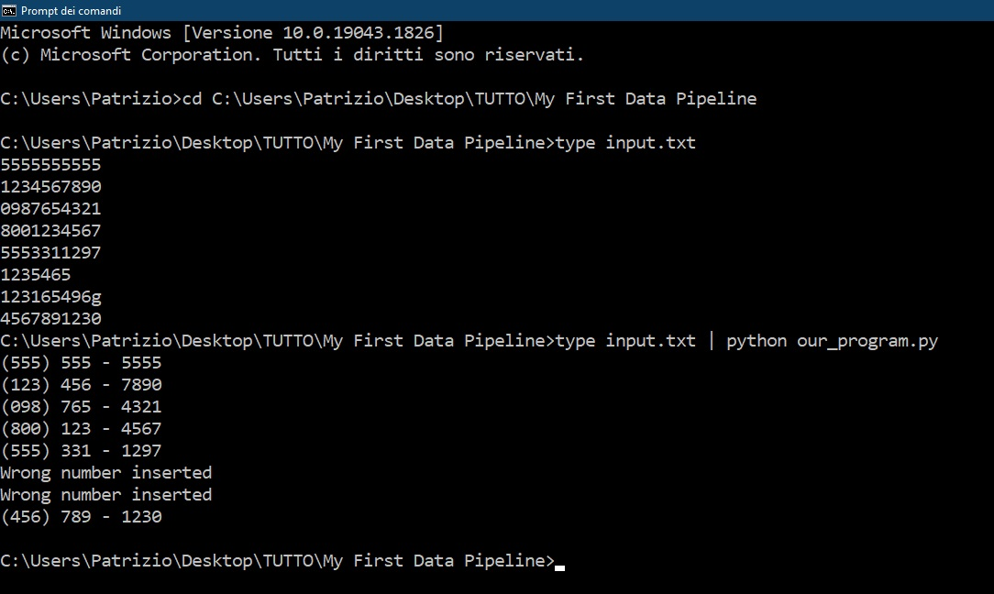
Check if program works
The program works as you can see from the last code run. The two rows before last are wrong and were detected

Slide 6
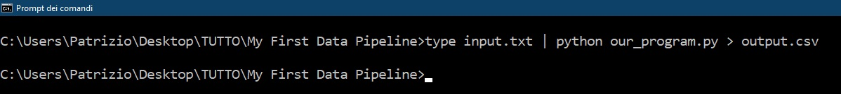
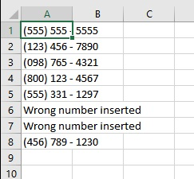
Input.txt shown with CMD
The final instruction for CMD is shown above and simply say to save an output. I specified in ‘.csv’ format.
On left we FINALLY have the output! A more usable file for successive Data science or Data analytics studies.

Slide 7
THE END

